Slide 1
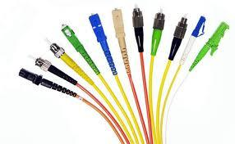
Optical Patch Cord Training Seminars

Slide 2
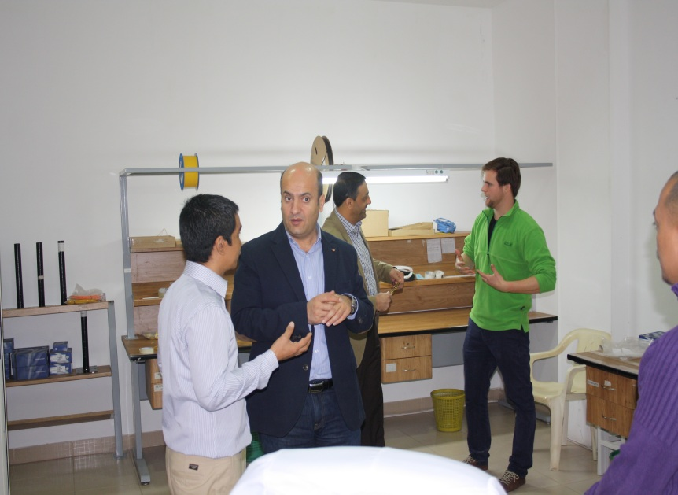
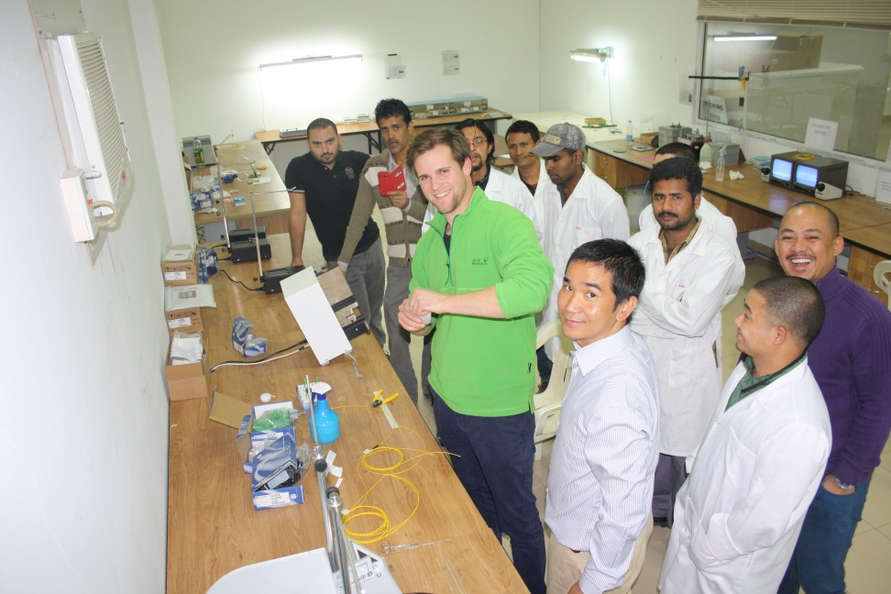
Introduction
Help Further knowledge
Communicating Competition
Helping Ability
Productive
Quality

Slide 3
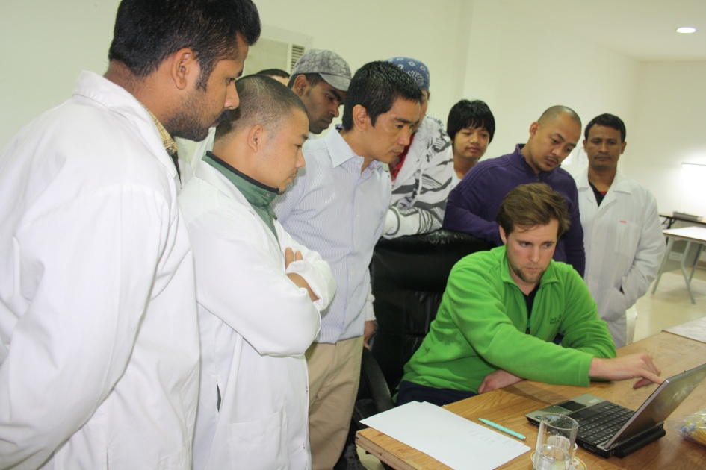
Briefings
Introduction
Familiarization
Collation

Slide 4
Preparations
Measurement Standard for Cable Strips

Slide 5
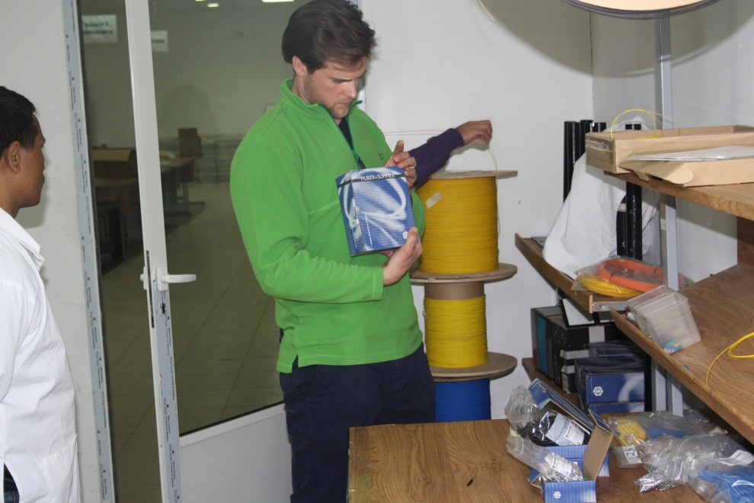
Preparations
Patch Cord Components
Cables
Connector Parts

Slide 6
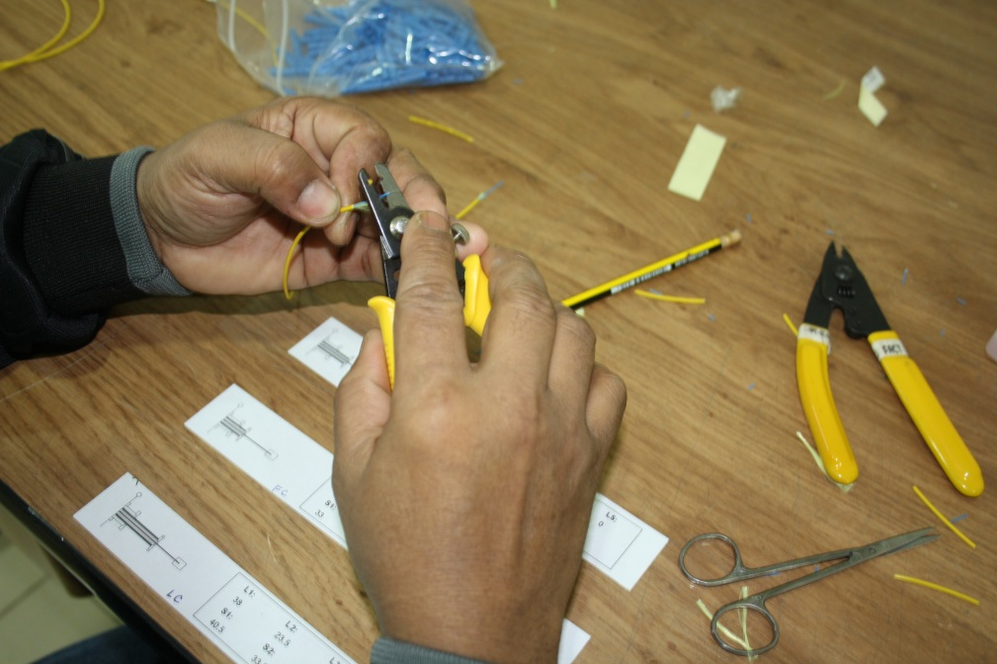
Cable Stripping
Strips in Standard Measurements
Depends on type of Connector
LC, SC, FC, E2000

Slide 7
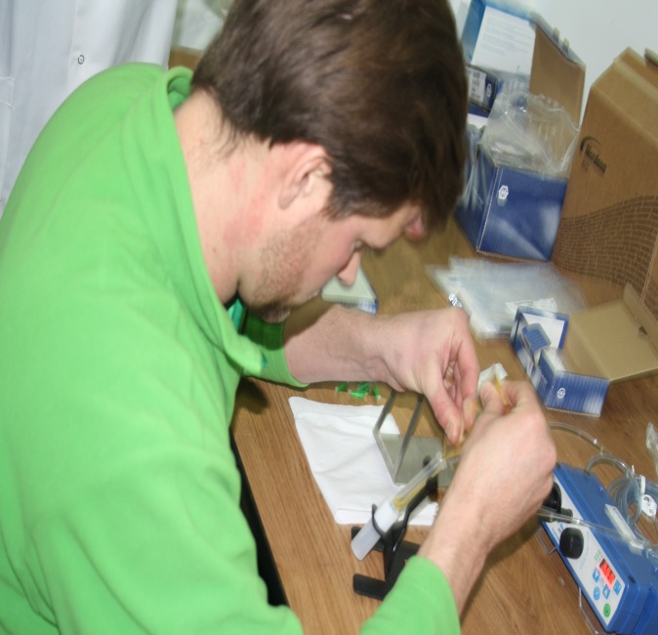
Glue Mixing
- Glue
- Hardener
Ratio : 10x1

Slide 8
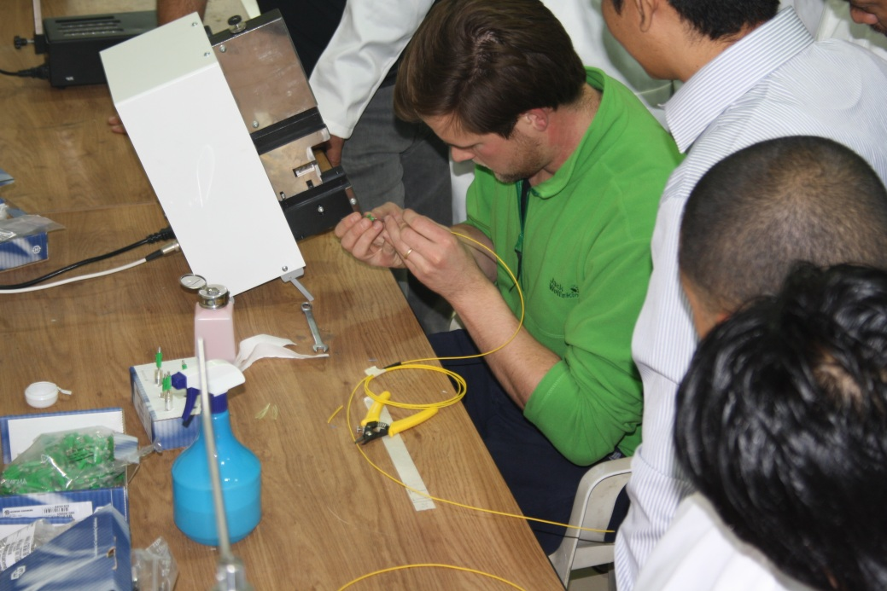
Inserting and Curing
Proper Inserting Bare fiber inside Ferrule
Removing excess glues around the Ferrule
Cleaning and Trimming

Slide 9
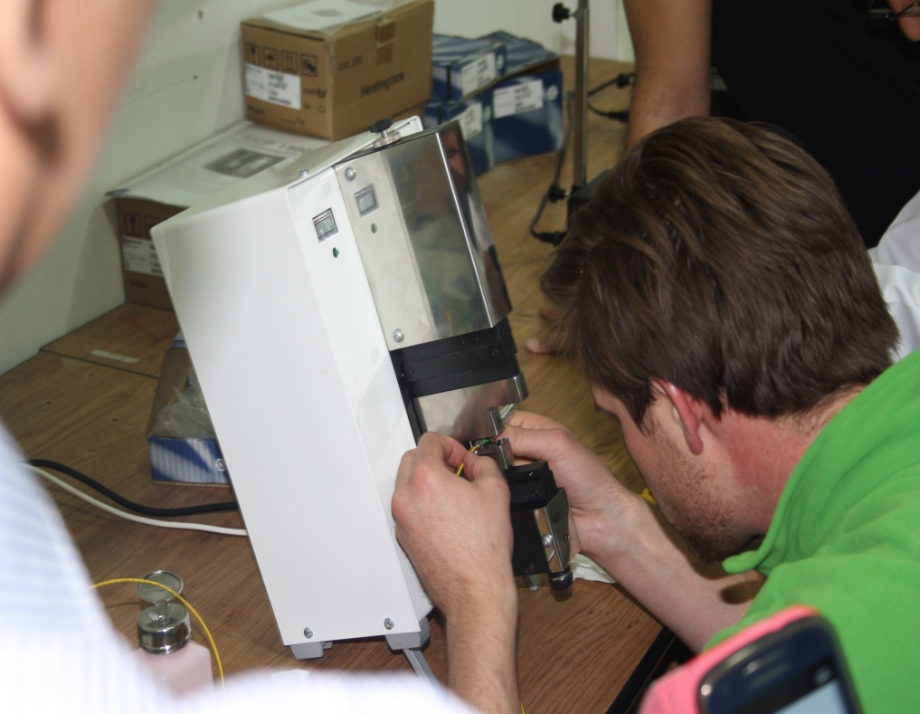
Termination and Crimp
Terminating the cable into Connector
Hold the cable firmly by connector

Slide 10
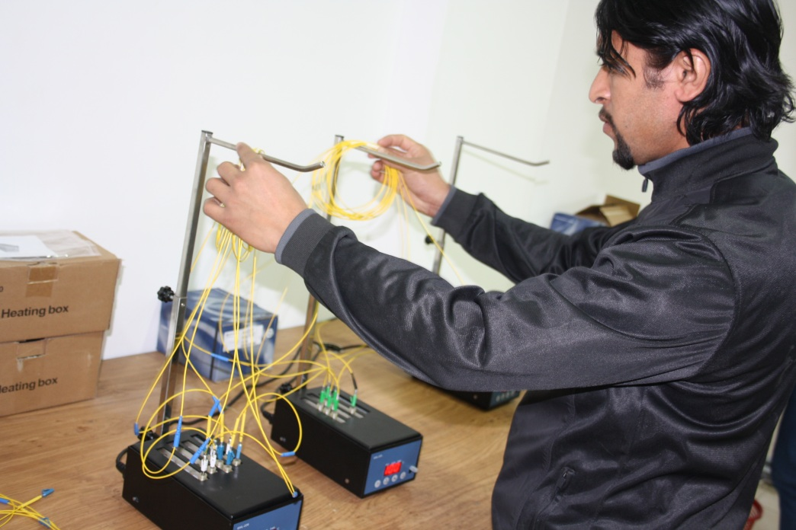
CURING
Heat of 100 degree Celsius up to 35 minutes to glue dried and firmed inside the ferrule.

Slide 11
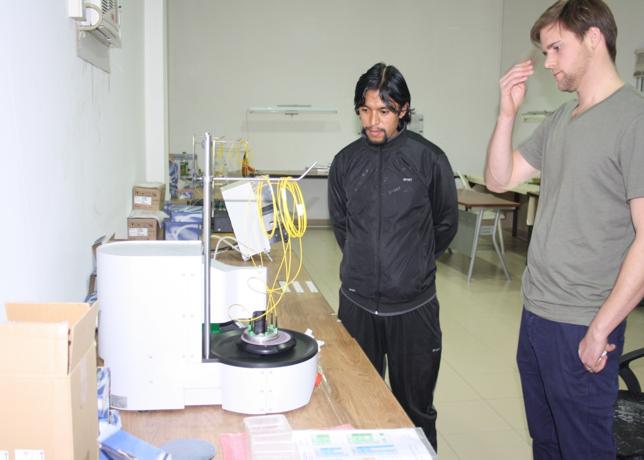
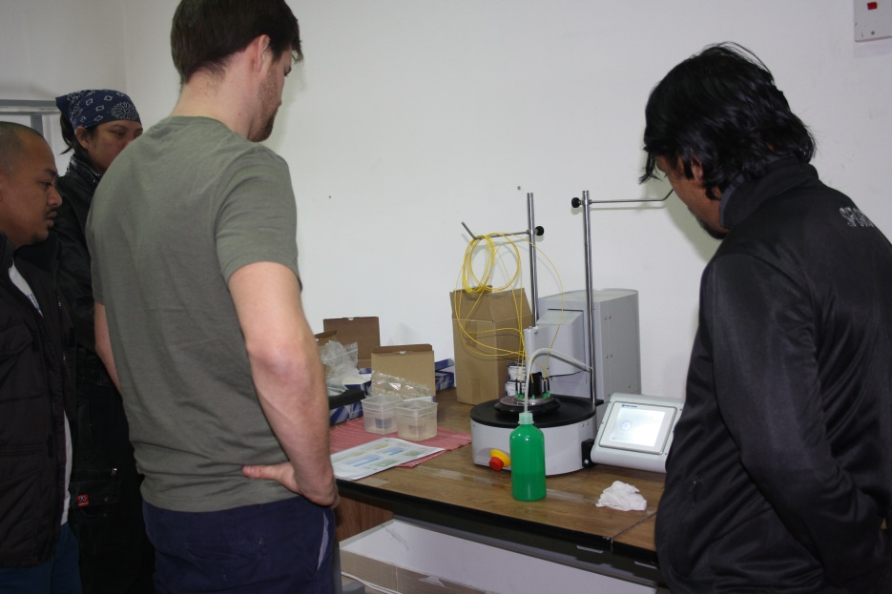
Automatic Polishing
End face Polishing of ferrule and Fiber
2.5mm Ceramic Ferrule (SC, FC)
1.25 Ceramic Ferrule (LC, MU)

Slide 12
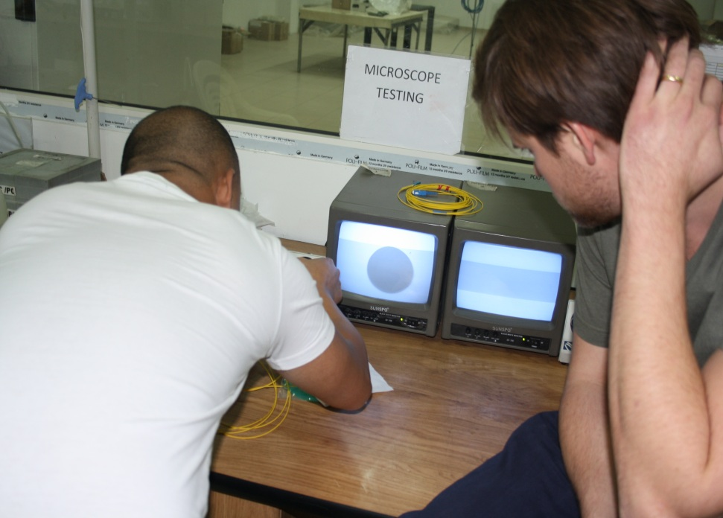
End Face Checking
Using Microscope to see the quality of polish to the end face of fiber and ferrule.

Slide 13
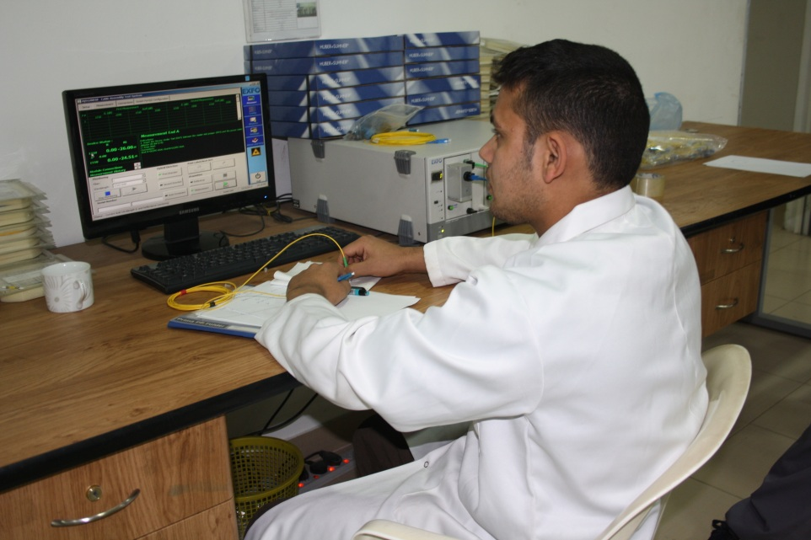
Final Testing
Using EXFO power meter machine is to test the quality or dB loss of fiber and connector
Insertion loss
Return loss / Reflection

Slide 14
Preventive Maintenance
Assuring that the tools and machine are proper maintained

Slide 15
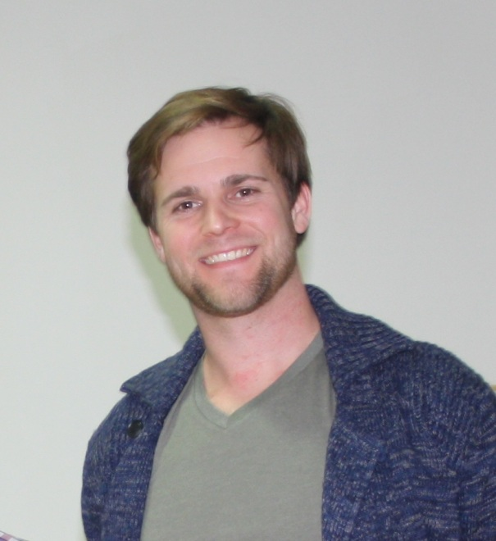
Successful
ARF Lab. Fiber Optic Team
Would like to thanks to the Management and Board Members of Al-Raghad Factory for conducting training regarding for Fiber Optic Patch Cord Assembly and opportunity to having this successful training, especially to complement our knowledge as desirable for the quality of our Fiber Optic Products
Instructor : Thomas Alder
Technical Manager

